Slide 1

Project name : Public transportation optimization Team name : Proj_224782_Team_4 Team members : ASHWINI E(113321104006) BENSIHA A(113321104008) DEYAA ASMI M(113321104013) DHANALAKSHMI S(113321104014)
DEPARTMENT OF Computer science and engineering

Slide 2
Innovation
Real-time Data and Predictive Analytics: Using sensors and data analysis to track the movement of buses and trains in real-time. This data can help predict delays and optimize schedules.
Dynamic Routing: Implementing dynamic routing systems that can adjust bus or train routes based on traffic conditions, passenger demand, and other variables.
Eco-friendly Vehicles: Transitioning to electric or hybrid buses and trains to reduce emissions and environmental impact.
Digital tickets: Enabling passengers to pay for rides with contactless methods, such as smartphones, smart cards, or biometrics, making the boarding process more efficient.
Multimodal Integration: Integrating various modes of public transport (buses, trains, trams, shared bikes, scooters) into a unified system with seamless transfers and a single payment platform.

Slide 3
On-Demand Services: Offering on-demand or shared-ride services that can be summoned via mobile apps to bridge transportation gaps in underserved areas.
Dynamic Pricing: Implementing dynamic pricing models to encourage off-peak travel and optimize vehicle occupancy.
Infrastructure Upgrades: Investing in modernized infrastructure, including dedicated bus lanes, efficient transfer hubs, and eco-friendly station designs.
Accessibility and Inclusivity: Ensuring that public transport is accessible to all, including people with disabilities and those with limited mobility.
Data-Sharing and Collaboration: Encouraging data sharing and collaboration between different public transport providers and agencies to create a more interconnected and efficient network.
Mini transpotation: Integrating small, flexible transit options to address first-mile and last-mile challenges in public transport networks.

Slide 4
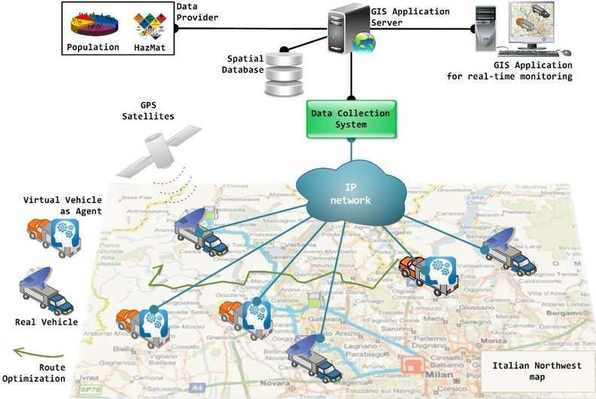
Iot sensors used in public transport optimization

Slide 5
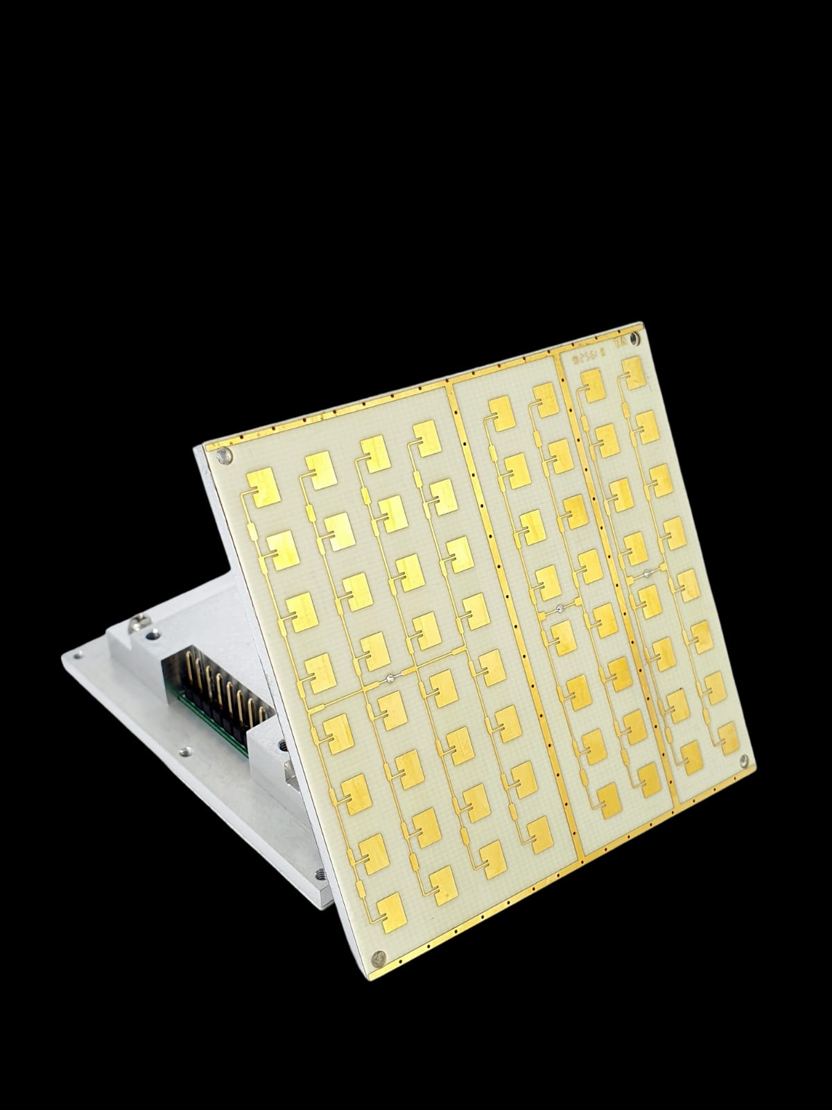
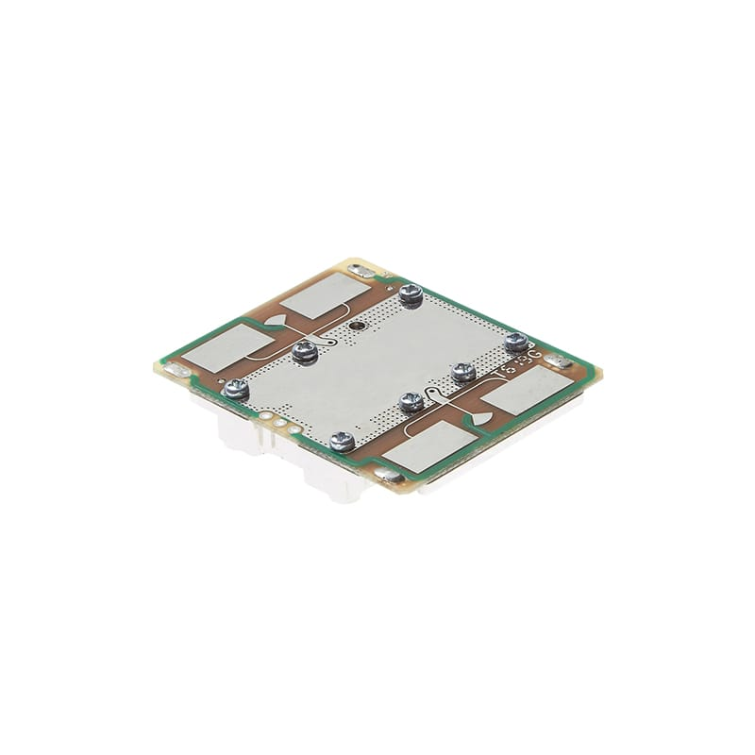
DF590-0 nDF800-0

Slide 6
IOT SENSORS USED IN PUBLIC TRANSPORT OPTIMIZATION
DF590-0 : The HB590 sensor belongs to the HB9 series that operates over various narrow bands in the X-band. It provides the optimum balance across emissions, range, coverage angle and power consumption in a low profile form factor. Its cost effectiveness makes it an ideal candidate as an alternative or complement to other types of sensors. Typical applications include security alarms, auto-door, motion-triggered lighting, and other applications that require general motion detection.
DF800-0 : The DF800 sensor belongs to the DF-series K-band sensors designed specifically for long range traffic applications. They are the ideal RF-frontend to provide precise speed measurements via 2 analog quadrature channels. It is designed to be lightweight and has a pre-amplifier with an extended dynamic range. Combined with its ultra-low standby power, the DF800 is also optimum for battery/solar-powered deployments. Typical applications include radar speed signs, traffic monitoring and sports radars.
Automatic Number Plate Recognition (ANPR) : Cameras are cameras that read and digitalize vehicles' number plates in real-time. These All-included cameras can do the whole detection/recording/process/transmitting process all by themselves, without servers or triggers, sending compact digital data instead of heavy videos/images.

Slide 7
SOLUTION
DECIDING ROUTES: Implement efficient routes that serve high-demand areas. Use data analysis to identify popular routes and adjust schedules accordingly.
Real-Time Tracking: Provide real-time tracking of buses or trains so passengers can plan their journeys better.
Smart Ticketing: Introduce contactless payment options like NFC cards or mobile apps to reduce boarding time.
Integration: Create a seamless network by integrating different modes of public transport, like buses, trams, and subways.
SPECIALIZED Lanes: Implement bus-only lanes and traffic signal priority to reduce congestion and travel time.

Slide 8
Route Planning: Implement efficient routes that serve high-demand areas. Use data analysis to identify popular routes and adjust schedules accordingly.
Real-Time Tracking: Provide real-time tracking of buses or trains so passengers can plan their journeys better.
Smart Ticketing: Introduce contactless payment options like NFC cards or mobile apps to reduce boarding time.
Integration: Create a seamless network by integrating different modes of public transport, like buses, trams, and subways.
Priority Lanes: Implement bus-only lanes and traffic signal priority to reduce congestion and travel time.

Slide 9
THANK YOU

